Slide 1
Logging Management
Zach Chih, Advantech

Slide 2
Outline
Troubleshooting
Options?
Questions
Grafana v6.0
Loki

Slide 3
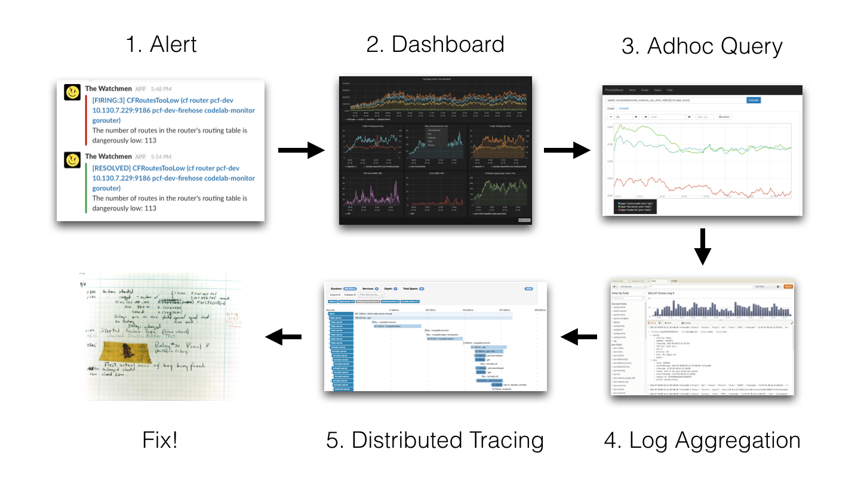
Flow : Troubleshooting

Slide 4
Flow : Troubleshooting

Slide 5
Options?
As the elastic stack contains various components (elasticsearch, kibana, logshipper from the beats familiy) it is far from a lightweight solution. Planing, sizing and operating a full-blown elastic stack might be complex—just like the other solutions mentioned above.

Slide 6
Questions
How can I integrate this new logfile management solution into our existing tooling?
how can I view my logfile events in grafana?

Slide 7
Grafana 6.0 新特性
Explore——一个全新的专注于查询的工作流，用于临时数据探索和故障排除
Grafana Loki——与来自 Grafana Labs 的最新开源日志聚合系统集成。
Gauge Panel——全新的独立 Gauge 面板。
新的 Panel Editor UX 改进了面板编辑功能，可以在不同的视图之间轻松切换
谷歌 Stackdriver 数据源已经完成测试并正式发布。
Azure Monitor 插件成为核心数据源。
React Plugin 让插件开发变得更轻松。
改进的颜色选择器。
移除用户会话存储，使 Grafana 更易于部署，并提高了安全性。

Slide 8
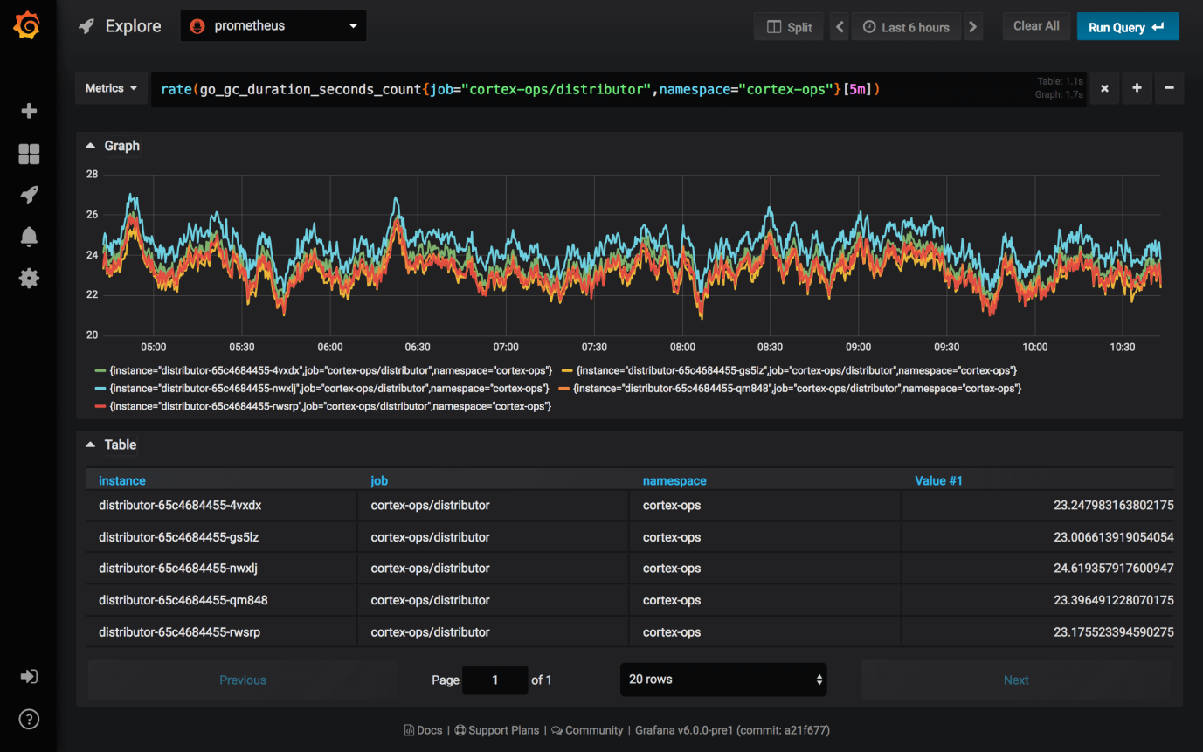

Slide 9
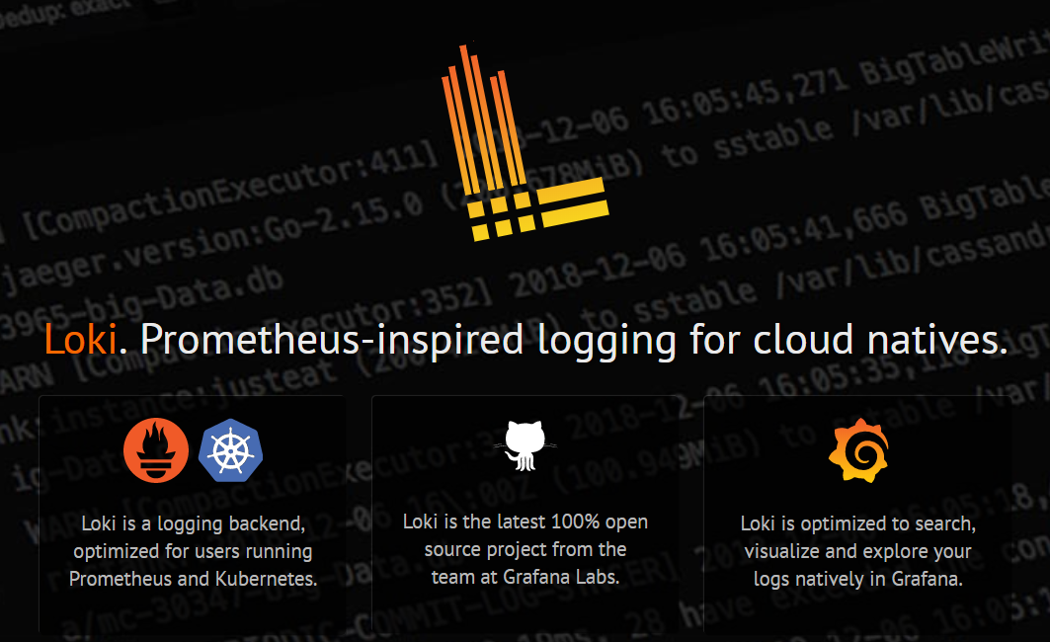
Loki. Prometheus-inspired logging for cloud natives.

Slide 10
Origin
Loki is derived from Cortex — a CNCF incubator project that Grafana Labs helps drive.
Cortex is a scale-out, multi-tenant implementation of Prometheus (another project we help drive) that powers our Grafana Cloud offering.
Loki is a new standalone project, but depends on a bunch of Cortex code. It’s a long, but distinguished lineage.

Slide 11
Aim for
Logs should be cheap. Nobody should be asked to log less.
Easy to operate and scale
Metrics, logs (and traces later) need to work together

Slide 12
Release
As of mid December 2018 there is a new option: Grafana released an alpha version of Loki, their approach to logfile management—and it integrates seamlessly into Grafana.

Slide 13
Features
a logfile aggregator that collects log streams. It does so by storing log streams as well as labels attached to them.
Loki works like Prometheus but for logs. Each log stream is indexed and its occurrence is tracked via a timestamp.

Slide 14
Differences
does not do full text indexing on logs. By storing compressed, unstructured logs and only indexing metadata, Loki is simpler to operate and cheaper to run.
indexes and groups log streams using the same labels you’re already using with Prometheus, enabling you to seamlessly switch between metrics and logs using the same labels that you’re already using with Prometheus.
is an especially good fit for storing Kubernetes Pod logs. Metadata such as Pod labels is automatically scraped and indexed.
has native support in Grafana (already in the nightly builds, will be included in Grafana 6.0).

Slide 15
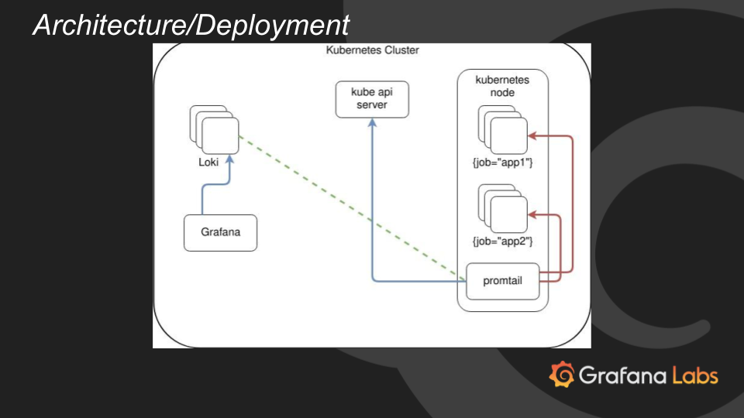
Architecture

Slide 16
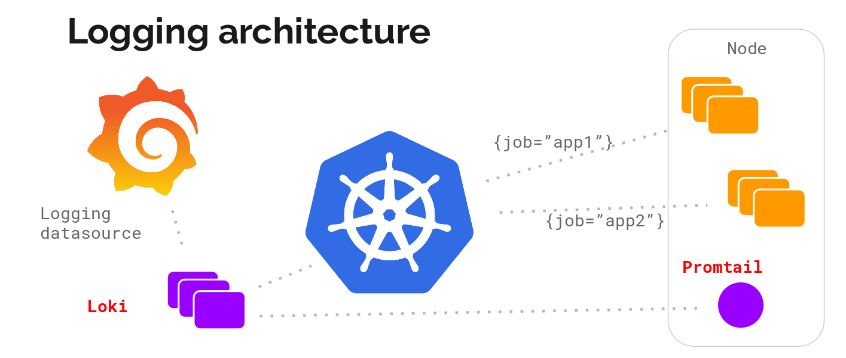
Architecture

Slide 17
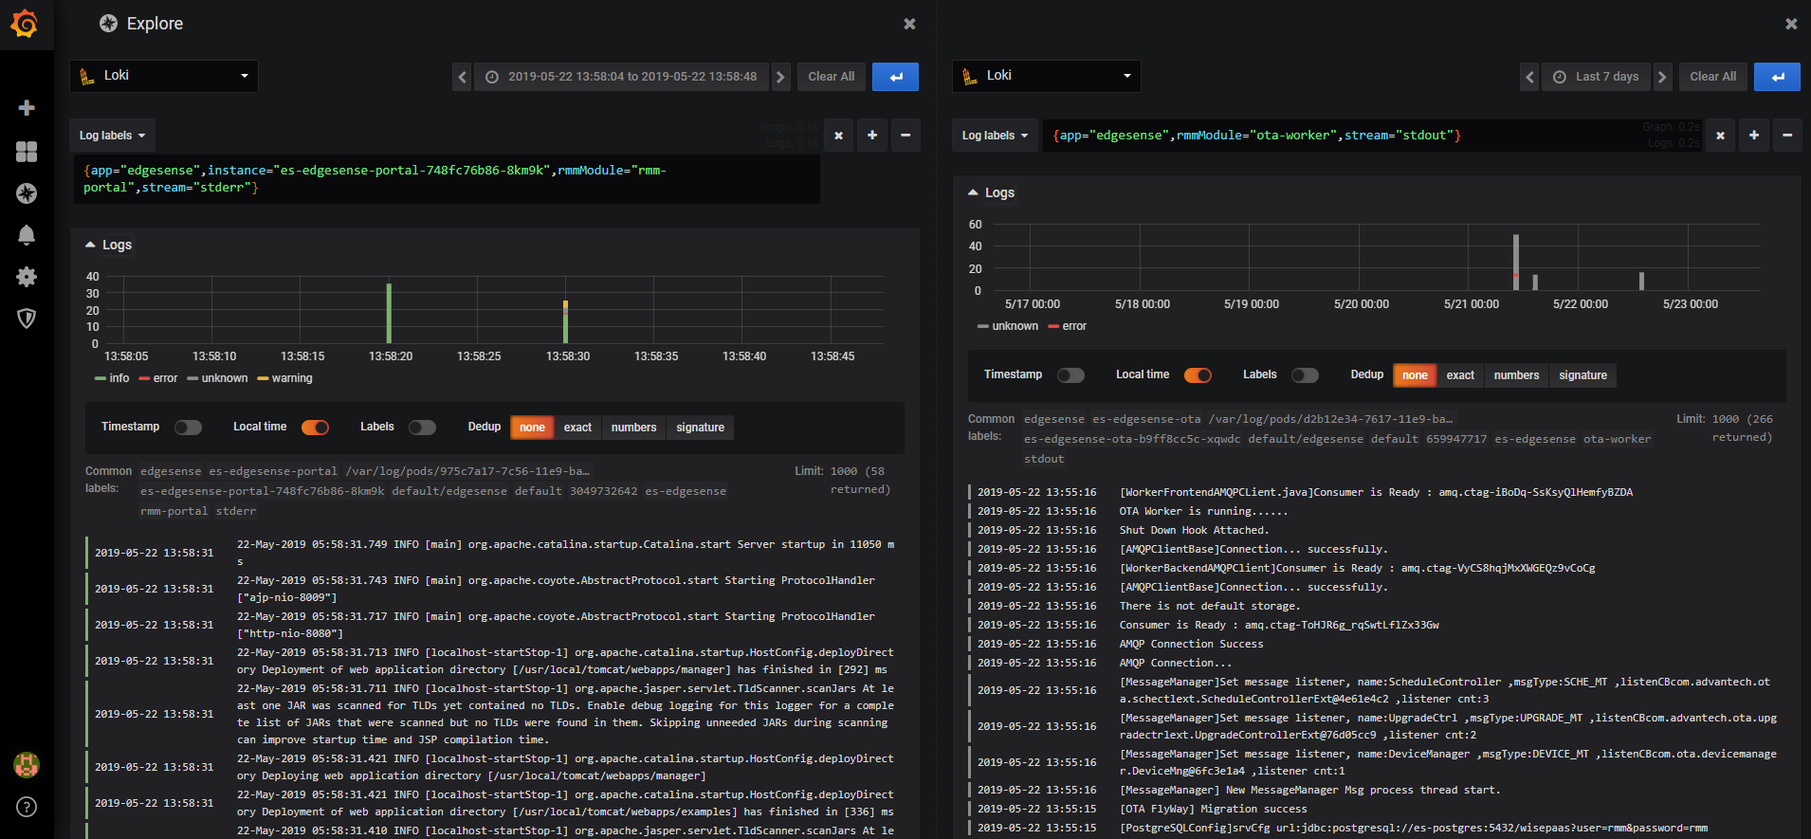

Slide 18

Demo

Slide 19
Summary
Loki could evolve into a good alternative to provide a lightweighted logfile management solution that integrates very easily into existing prometheus tooling.

Slide 20
Go Together,
We Go Far and Grow Big

